Slide 1
CSE 5914 – Almost Grads
Watson Weather Project
John Herwig, Luke Swint, Holland Clarke
Notes:
struggled wit fligh thing, too many results for airport code, demo of what happened there, and then hwth hdigh thj ji, final have all weather stuff working perfectly

Slide 2
CSE 5914 – Almost Grads
Our Application – Background
Goal
Create easy to use web app that integrates IBM Watson Assistant to provide active communication and suggestions in daily planning
Identify Best Use Cases
Notes:
struggled wit fligh thing, too many results for airport code, demo of what happened there, and then hwth hdigh thj ji, final have all weather stuff working perfectly

Slide 3
CSE 5914 – Almost Grads
Our Application – Background
Goal
Create easy to use web app that integrates IBM Watson Assistant to provide active communication and suggestions in daily planning
Identify Best Use Cases
Issue: Difficult to coordinate plans around weather
Solution: Connect a weather API to gather info
Notes:
struggled wit fligh thing, too many results for airport code, demo of what happened there, and then hwth hdigh thj ji, final have all weather stuff working perfectly

Slide 4
CSE 5914 – Almost Grads
Our Application – Background
Goal
Create easy to use web app that integrates IBM Watson Assistant to provide active communication and suggestions in daily planning
Identify Best Use Cases
Issue: Difficult to coordinate plans around weather
Solution: Connect a weather API to gather info
Issue: Coordinating flights around weather
Solution: Connect flight API and utilize data with weather information
Notes:
struggled wit fligh thing, too many results for airport code, demo of what happened there, and then hwth hdigh thj ji, final have all weather stuff working perfectly

Slide 5
CSE 5914 – Almost Grads
Our Application – Background
Goal
Create easy to use web app that integrates IBM Watson Assistant to provide active communication and suggestions in daily planning
Identify Best Use Cases
Issue: Difficult to coordinate plans around weather
Solution: Connect a weather API to gather info
Issue: Coordinating flights around weather
Solution: Connect flight API and utilize data with weather information
Notes:
struggled wit fligh thing, too many results for airport code, demo of what happened there, and then hwth hdigh thj ji, final have all weather stuff working perfectly

Slide 6
CSE 5914 – Almost Grads
Our Application – Background
Goal
Create easy to use web app that integrates IBM Watson Assistant to provide active communication and suggestions in daily planning
Identify Best Use Cases
Issue: Difficult to coordinate plans around weather
Solution: Connect a weather API to gather info
Issue: Coordinating flights around weather
Solution: Connect flight API and utilize data with weather information
Issue: Setting dinner plans around the weather
Solution: Connect a dinner API and utilize data with weather information
Notes:
struggled wit fligh thing, too many results for airport code, demo of what happened there, and then hwth hdigh thj ji, final have all weather stuff working perfectly

Slide 7
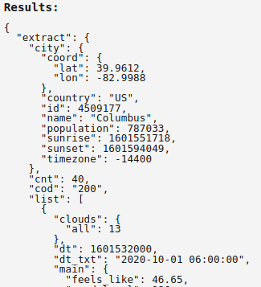
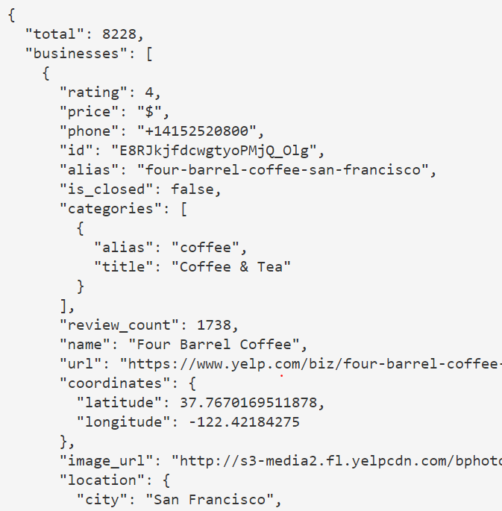
CSE 5914 – Almost Grads
Our Application
Weather Portion
Given location info, Chatbot provides weather data
Connected to OpenWeatherMap API
Restaurant Portion
Using location/weather date, Chatbot provides a location suggestion
Connected to Yelp API
Notes:
struggled wit fligh thing, too many results for airport code, demo of what happened there, and then hwth hdigh thj ji, final have all weather stuff working perfectly

Slide 8
CSE 5914 – Almost Grads
Current State
Properly Working
Site deployed to Heroku
Attractive and completely functional UI
Provides all weather info given a location
Provides all near-by restaurant info given a location
Specification of food types
Recommendations of outdoor vs indoor
Roadblocks
City Specification w/ weather info
Flight API – pricing, location specification, parsing results
Notes:
struggled wit fligh thing, too many results for airport code, demo of what happened there, and then hwth hdigh thj ji, final have all weather stuff working perfectly

Slide 9
CSE 5914 – Almost Grads
Potential Future Additions
Functionality
Flight API
Auto tracking person’s location
Appearance
Continuous refinements of the UI
Correctness
Add dialog to Chatbot to understand different word phrasing and mistypes

Slide 10
Demo

